Slide 1
Macbeth and Throne of Blood (1957)
By Stephanie Washburn

Slide 2
Preamble: macbeth’s Heath
Implied Setting, any scene outside the castles and England takes place here.
Rarely important enough to a scene be described in dialogue.
Therefor the heath and its qualities can be known only through what happens there
HEATH:
1. a tract of wasteland
1b: an extensive area of rather level open uncultivated land usually with poor coarse soil, inferior drainage, and a surface rich in peat or peaty humus.
—Merriam-Webster

Slide 3
Heath: the place of evil
Hecate, to the Weird Sisters:
“Get you gone, / And at the pit of Acheron / Meet me I’ th’ morning. Thither [Macbeth] / Will come to know his destiny” (pp111; III.5.14-16).
Acheron: the river of woe marking the boundary between Hades and the living world (Wikipedia, “Acheron”).
Macbeth. (1820) by John Martin

Slide 4
Heath: witches and murderers
“First Murderer: Then stand with us. -- / The west yet glimmers with some streaks of day. / Now spurs the lated traveler apace / To gain the timely inn, and near approaches / The subject of our watch. . . .” (pp97; III.3.7-10).
A treacherous place where a man might murder his best friend.
A place where agents of the devil can conspire to tempt men with evil prophesy.
“First Witch: When shall we three meet again? / In thunder, lightning, or in rain?
Second Witch: When the hurly-burly’s done, / When the battle’s lost and won.
Third Witch: Where the place?
Second Witch: Upon the heath.
Third Witch: There to meet Macbeth.”
(pp7; I.1.1-8).

Slide 5
Throne of Blood: Spider’s Web Forest
Combines the images of the Heath with Birnam Forest
Not a place of pure evil
Protects the castle with its “web”
Macbeth: “So foul and fair a day I have not seen” (I.3.39).
Washizu: “What is this day? I have never seen such peculiar weather.”

Slide 6
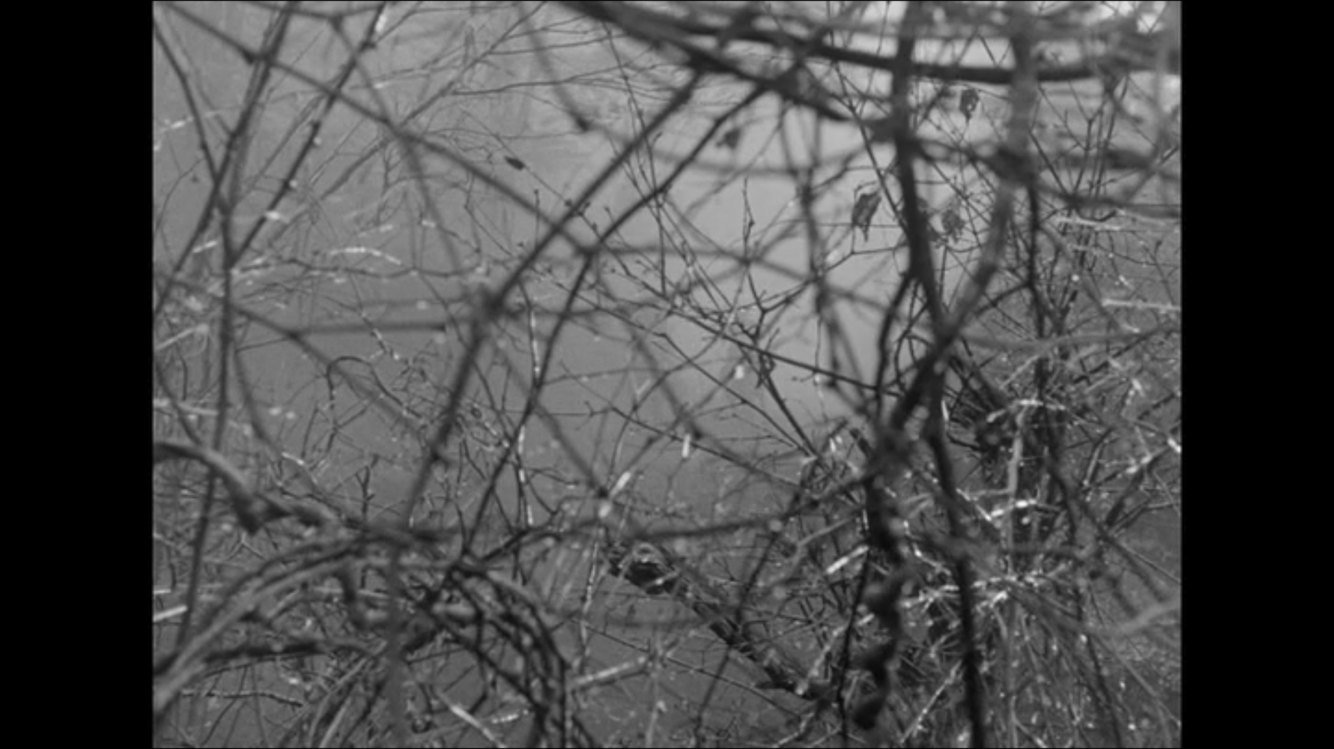
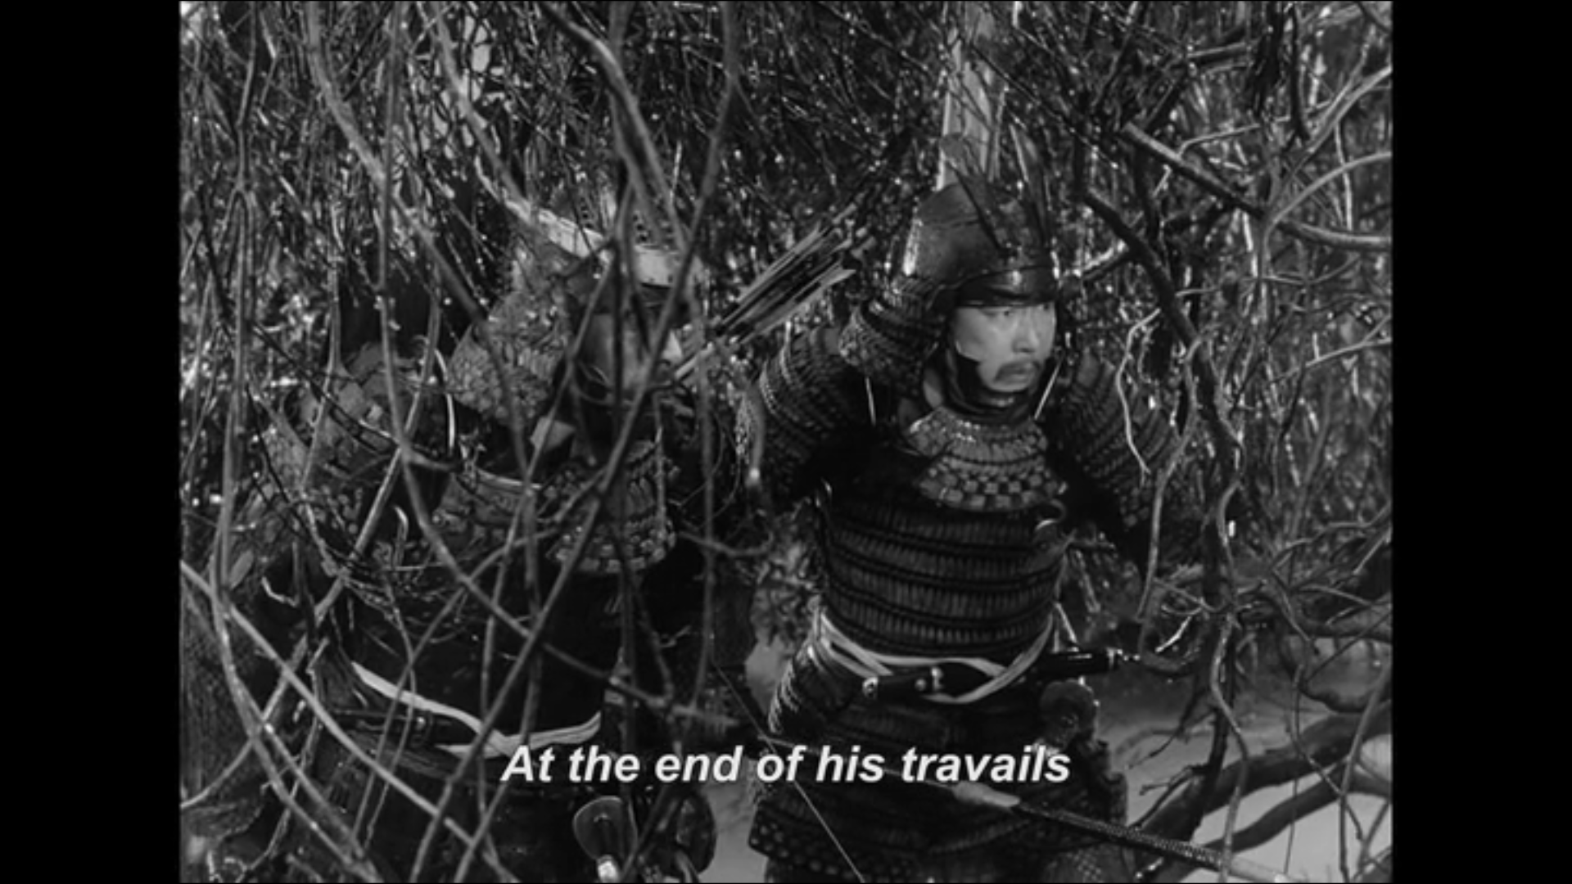
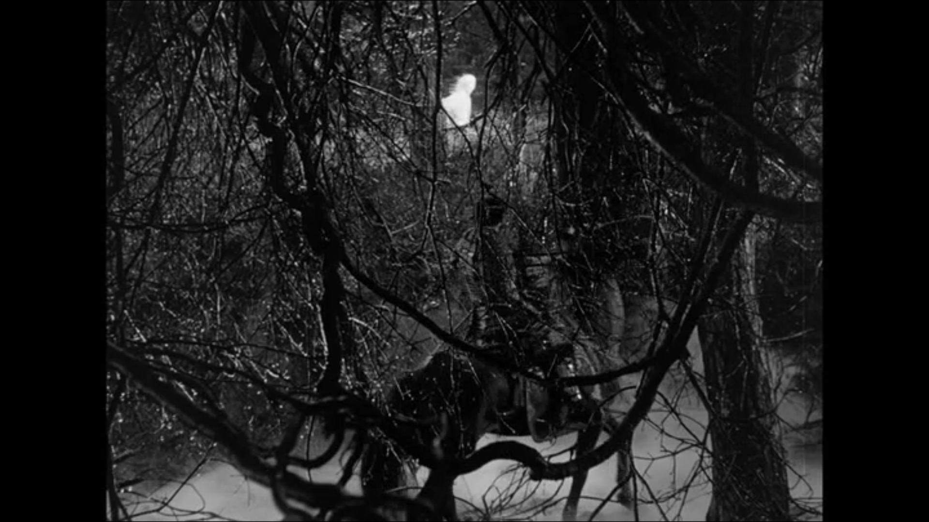
Spider’s Web Forest as a web
Miki: “The infamous Spider’s Web Forest stretching out like a spider’s web, protecting Spider’s Web Castle against all foes.”
Washizu: “Ridiculous. Though perilous to our foes, surely we know this forest well.” (after being lost for two hours in the woods, Throne of Blood (1957).

Slide 7
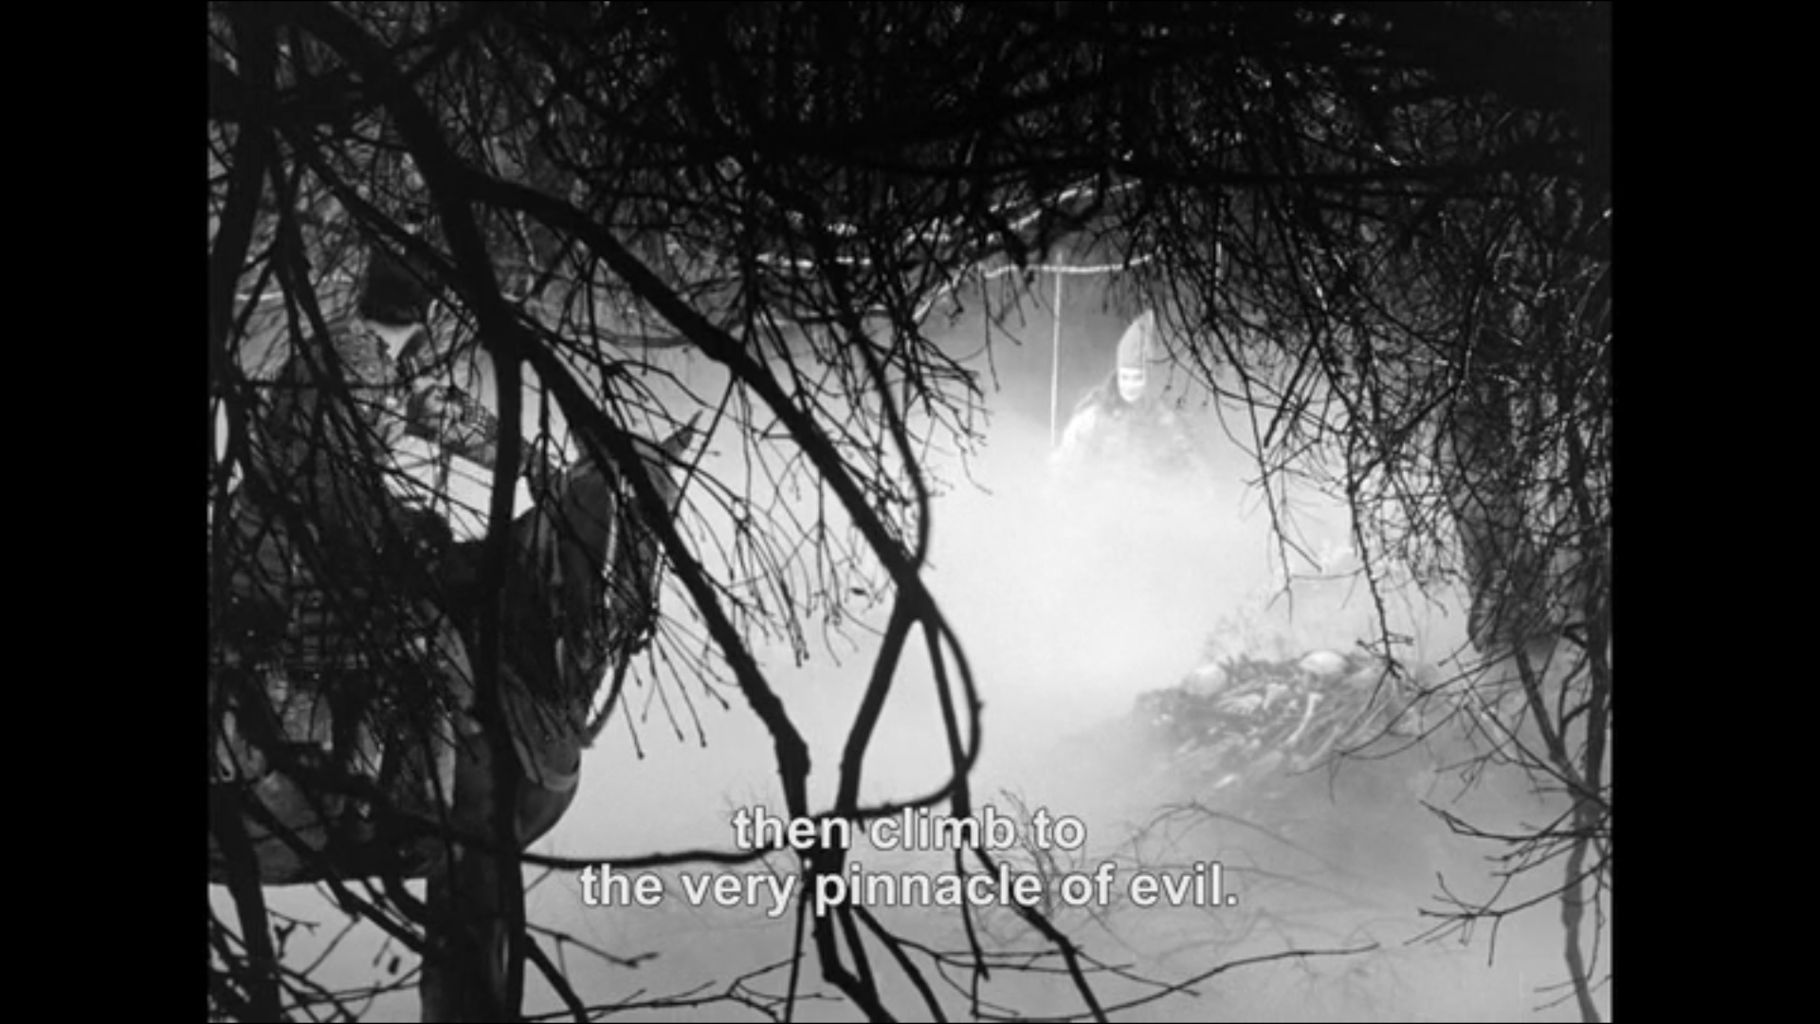
Spider’s Web Forest as Ashura Hell
“All that awaits man
at the end of his travails
is the stench of rotting flesh
that will yet blossom into flower.
Its foul odor rendered into sweet perfume.”
“If you choose the Ashura path of bloodshed, then climb to the very pinnacle of evil.”
Lennox: “Or so much [warlike medicine] as it needs / To dew the sovereign flower and drown the weeds” (pp167; V.3.35-37).

Slide 8
Sources
Kurosawa, Akira. Throne of Blood. 1957. Toshiro Mifune, Isuzu Yamada.
Shakespeare, William. Macbeth. Folger. Ed. Barbara Mowat, Paul Werstine. Simon & Schuster: New York, 1992.
Macbeth. (1820) by John Martin
Stills from Throne of Blood taken by myself.

